Slide 1


SMART INDIA HACKATHON 2024
TITLE PAGE
Problem Statement ID –1666
Problem Statement Title-Career Counselling and
Guidance Program Enhance Student Career Choice.
Theme-Smart Education
PS Category- Software
Team ID-
Team Name- TEAM FALCON

Slide 2
IDEA TITLE
TEAM FALCON
Problem Resolution :
Brainstorm options – Generate a list of potential solutions to the problems.
Integration of Technology:- The National Education Policy (NEP) 2020 emphasizes the need for holistic education, which includes providing students with the guidance necessary to make informed career choices.
IDEA / SOLUTION :
Implementation of a Career Counselling and Guidance Program Mechanism specialized for New younger gen..
Student Profile Setup
Creating Room for Self-Exploration by providing Mentorship Counsellors.
AI suggestion for career path.[For PURSUITS]
Unique UID,phone number to auto authenticate/authorize user .
Alternative Developing a Therapeutic Relationship.
Building Confidence and Self-Esteem by identifying strength and there accomplishments.
Helping Turn Life Themes into Career Goals By giving one to one video conference with Counselors.
Unique Value Propositions (UVP) :
Tailored Guidance:-Provide personalised career roadmap
Alumni Network:-Offer access to network of Successful Alumni.
Holistic Support:- Provide Academic Support and Technology – Enabled Platform

Slide 3
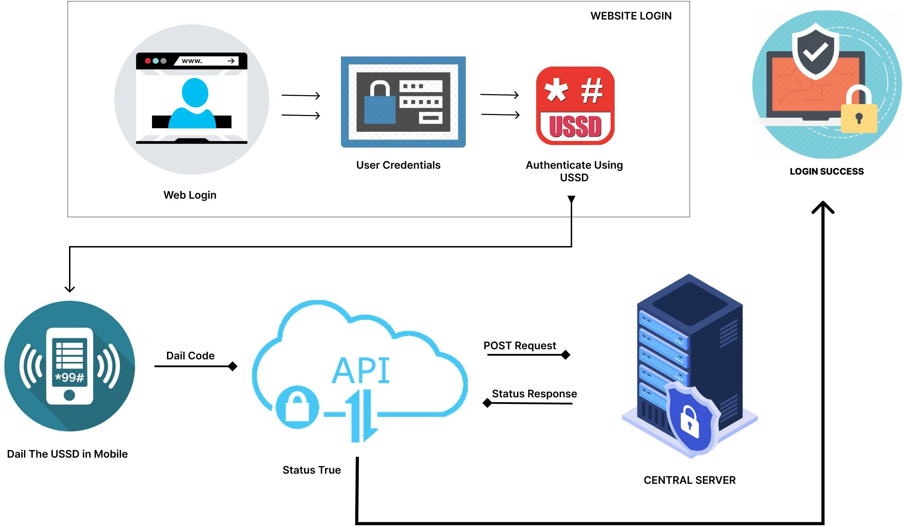
TECHNICAL APPROACH
TEAM FALCON
PROCESS FLOW ARCHITECTURE
Algorithm Development:
Next.js & Express.js & HTML,CSS,JS,AI(NLP MODEL) - Core technologies used for developing the Mentor Matching Algorithm.
Mobile Application Development:
Flutter - Framework used for building the mobile application, ensuring cross-platform compatibility.[React Native,Swift and Kotlin]
Encryption and Security:
Custom encryption algorithm powered by 8 layer octa 512 bit encryption for secure data transmission and authentication.
Cloud Services:
MySQL - Relational database management
PHP - High responsive Rest APIs
Product Status: 60% product built completed and further build is on progress. Testing and validation process are next to be undergone

Slide 4
FEASIBILITY AND VIABILITY
TEAM FALCON
Feasibility of the idea
Potential challenges and risks
Strategies for overcoming these challenges
Technical Feasibility:-Mobile App Development & Ai – Powered Career Coaching.
Market Feasibility:- Market Demand & Competitive Landscape.
Financial Feasibility:-Development Costs & Revenue Streams & Break – Even Analysis.
Technical Risks:-Includes the Complexity of AI – powered career coaching and personalized career.
Market Risks:-Includes Competition , market demand and ability to differentiate the program.
Financial Risk:-Development Costs , the ability to achieve profitability.
Mitigation Strategy:-Conduct market research to better understand Target Market.
Contingency Plan:-Develop a flexible marketing strategy that can be based on market feedback.

Slide 5
IMPACT AND BENEFITS
TEAM FALCON
Potential impact on the target audience
Benefits of the solution
Positive- Improvement in Career Clarity , Enhanced Career Development , New Opportunities with better Career Choices, social benefits with Improved Mental Health and Well-Being.
Negative- Cost, Technology Adoption Issues, Overreliance on Technology, Bias in AI Decision – Making.
Social - Improved Access, Empowerment, Reduction, Increased Diversity and Inclusion.
Economic – Productivity, Cost, Market , Increased Innovation , Enhanced Competitiveness,
Reduce Skill Gap.
ENV – Energy, Reduction, Waste, Empowering Sustainable Careers.

Slide 6
RESEARCH AND REFERENCES
TEAM FALCON
Details / Links of the reference and research work
https://www.nrtec.in/career-guidance/
https://www.indiamart.com/proddetail/career-planning 7004443112.html
https://www.quora.com/How-important-is-career-guidance-in-helping-students-make-informed-decisions-about-their-future

